Slide 1
U-Net: Convolutional Network for Segmentation
Presented by: EhsanLak

Slide 2

To access the files and code, use the address: https://github.com/Ehsunpy/Image-Segmentation

Slide 3

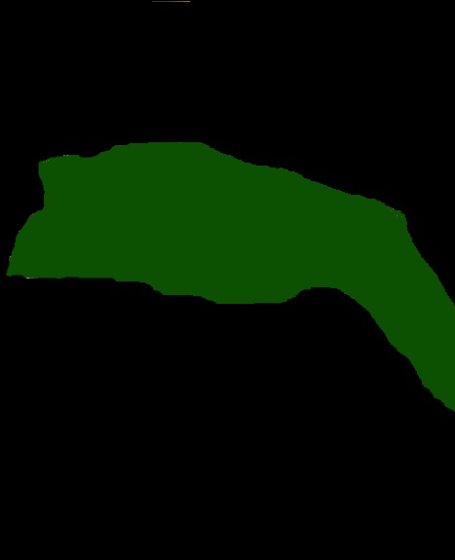
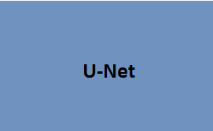
What does a U-Net do?
Learns Segmentation
Input Image
Output Segmentation Map

Slide 4

U-Net Architecture
Ronneberger et al. (2015) U-net Architecture

Slide 5
U-Net Architecture
“Contraction” Phase
- Increases field of view
- Lose Spatial Information
Ronneberger et al. (2015) U-net Architecture

Slide 6
U-Net Architecture
“Expansion” Phase
Create High Resolution
Mapping
Ronneberger et al. (2015) U-net Architecture

Slide 7
U-Net Architecture
Concatenate with high-resolution feature maps from the Contraction Phase
Ronneberger et al. (2015) U-net Architecture

Slide 8
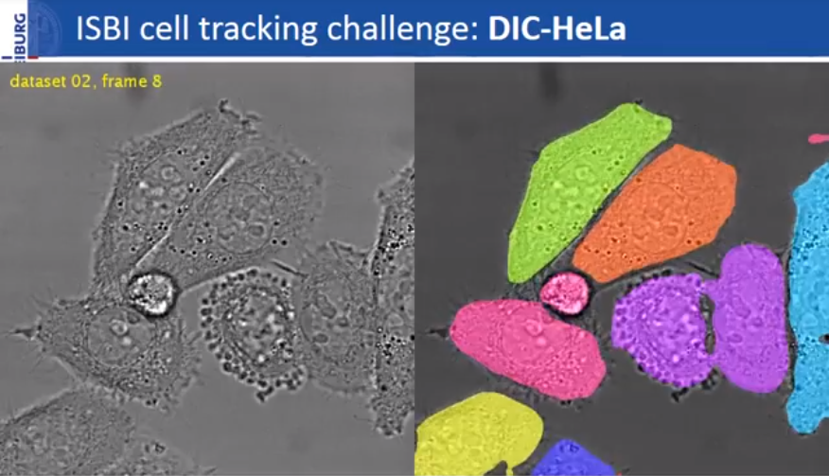
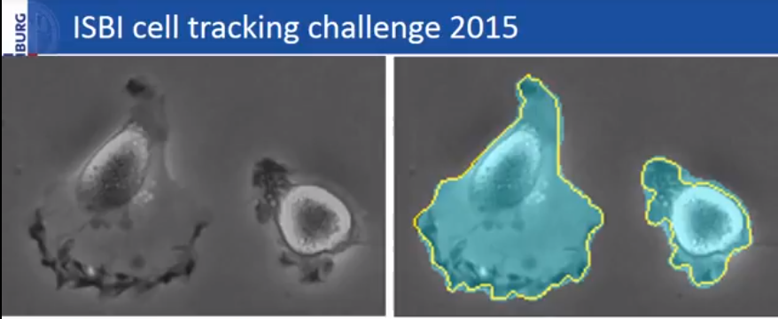
Author Results
Ronneberger et al. (2015) ISBI cell tracking challenge

Slide 9
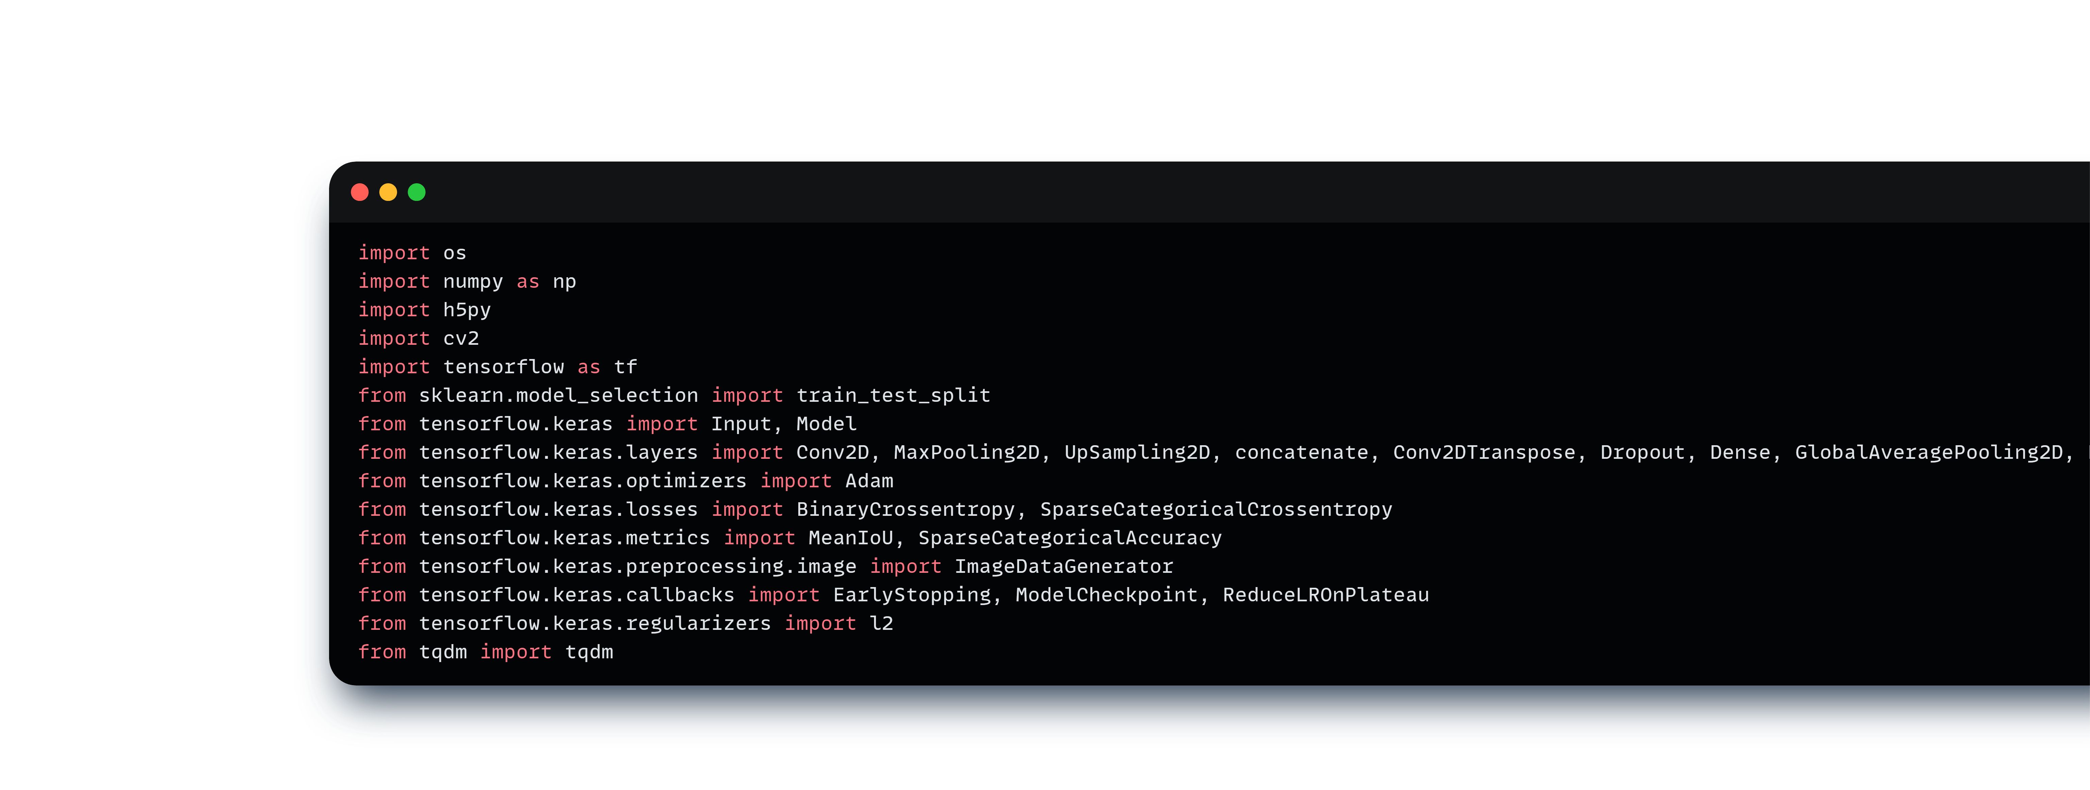
My methods
Import Python Libraries

Slide 10
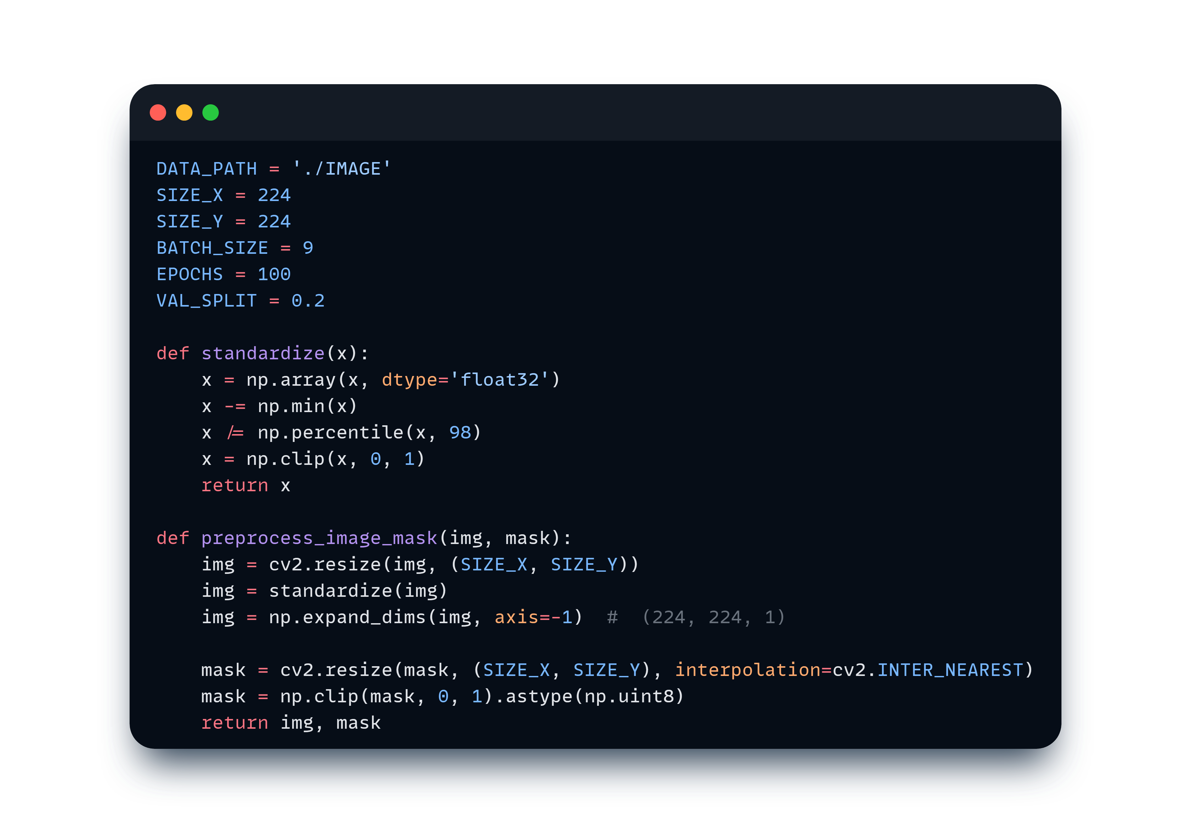
Normalize

Slide 11
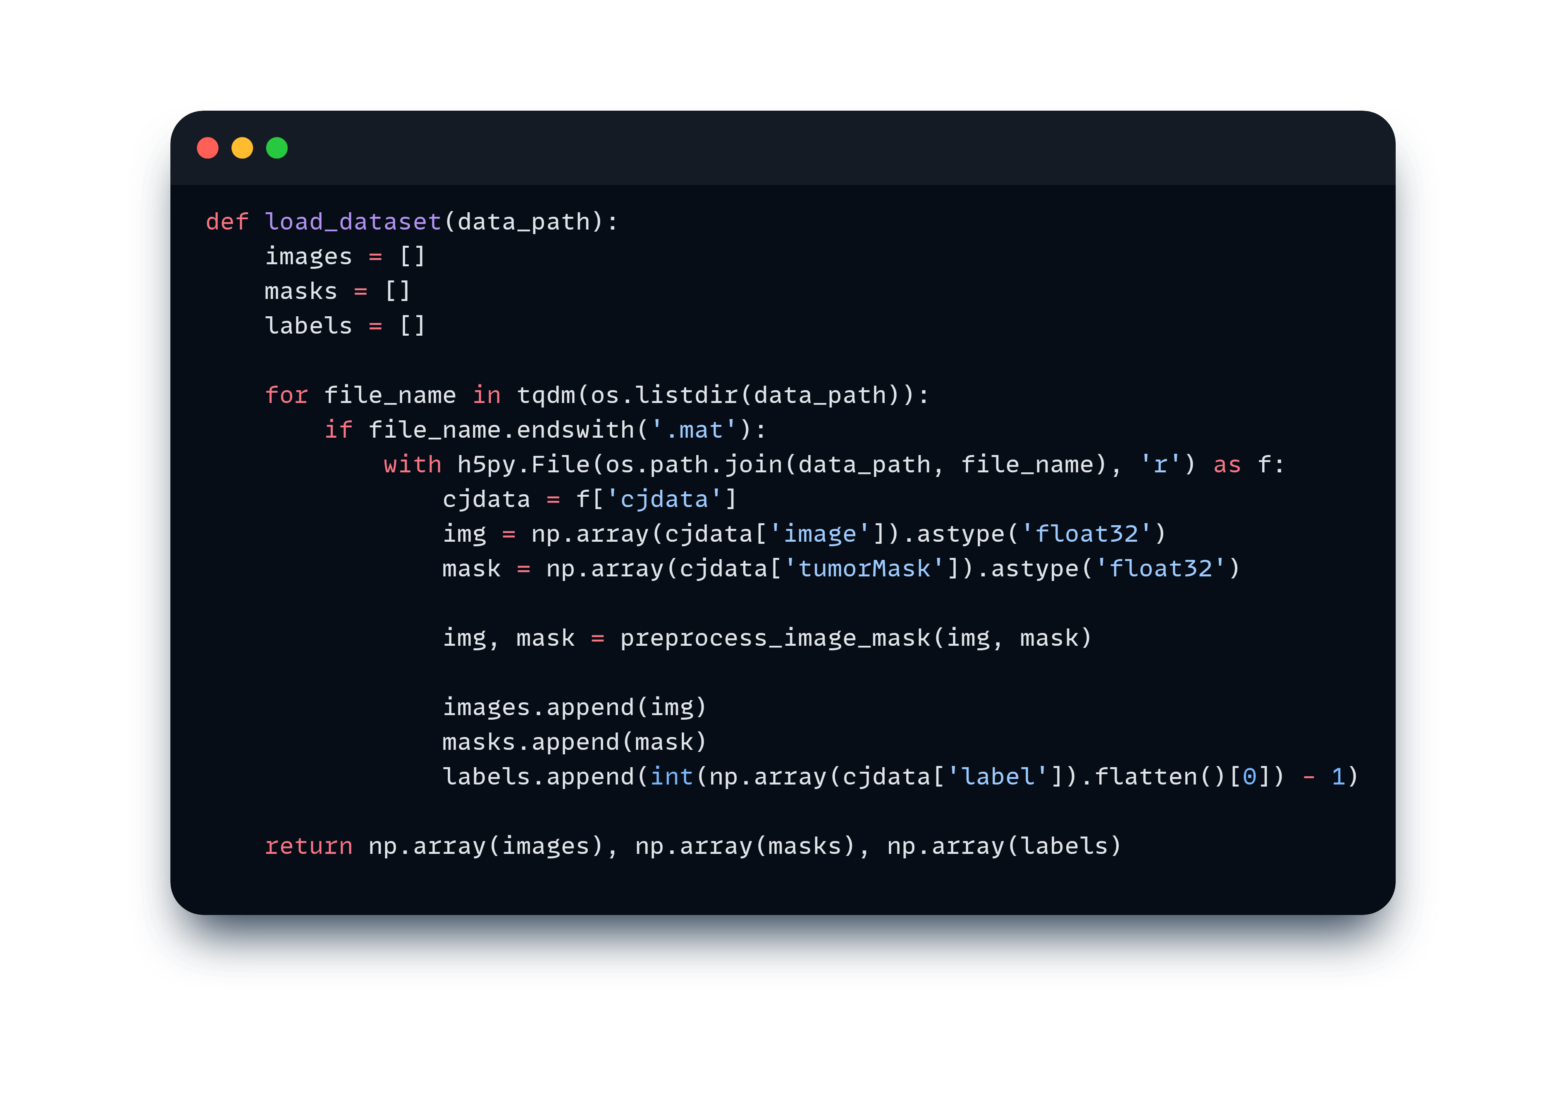
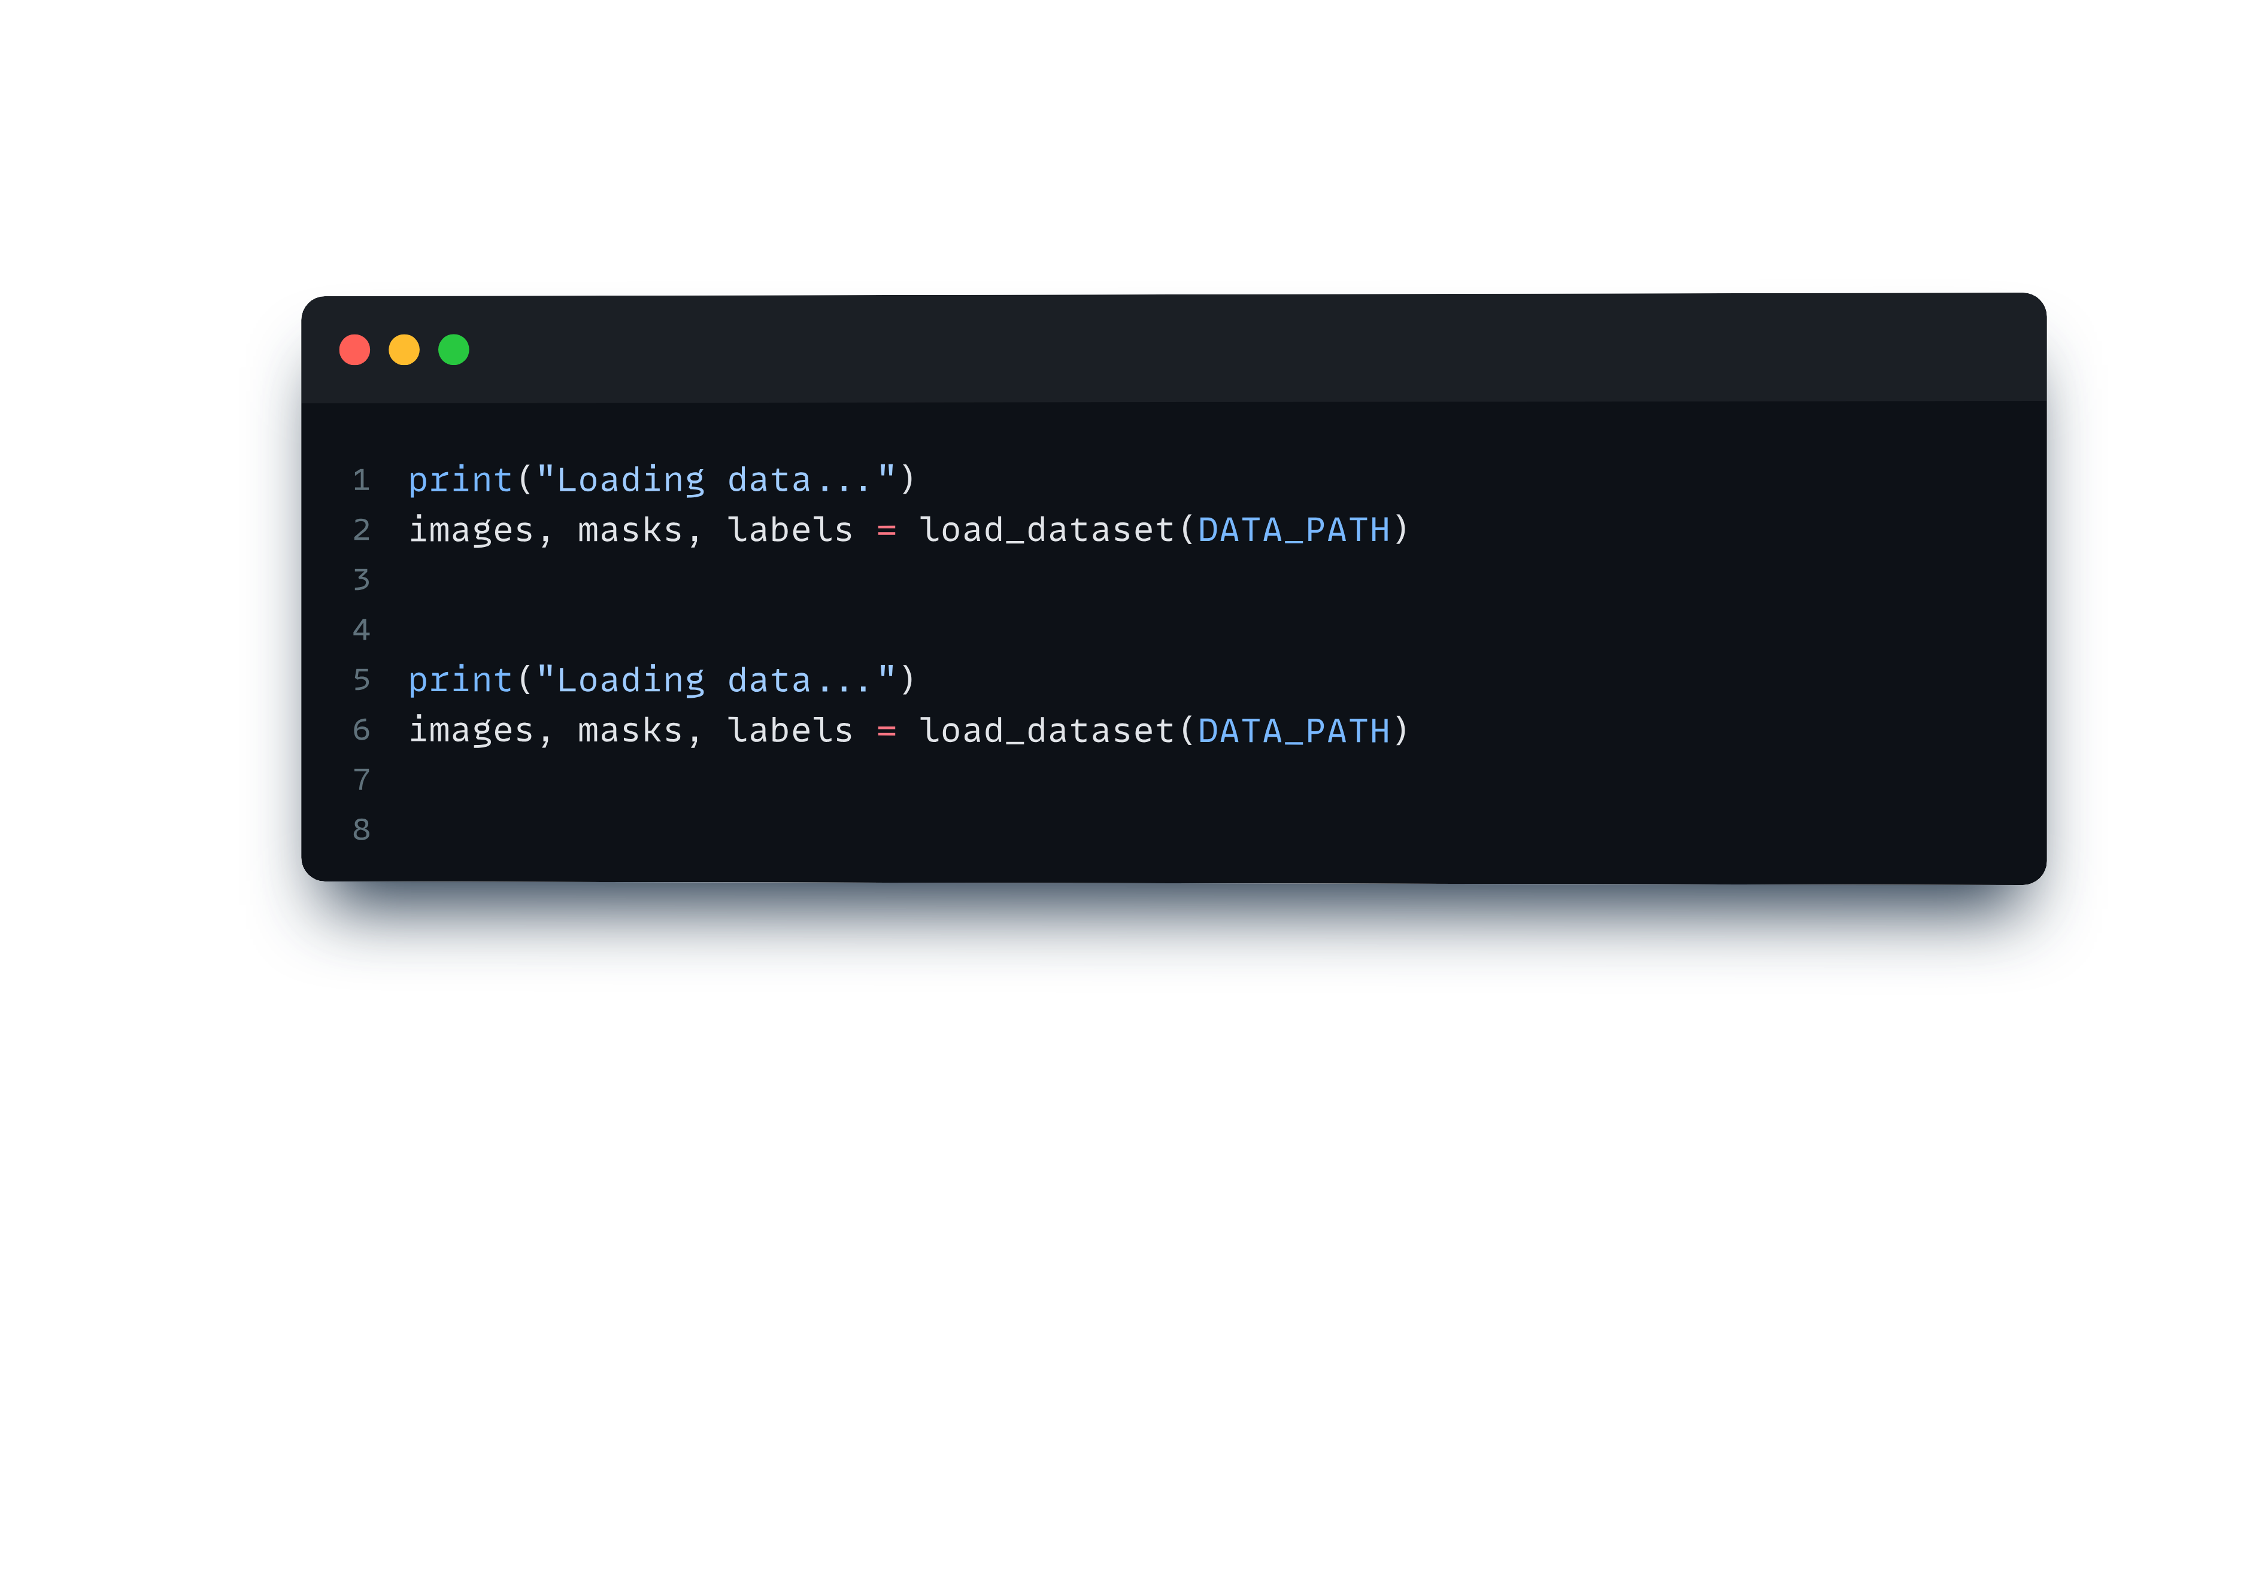

Load dataset
Link dataset:https: //figshare.com/articles/dataset/brain_tumor_dataset/1512427

Slide 12
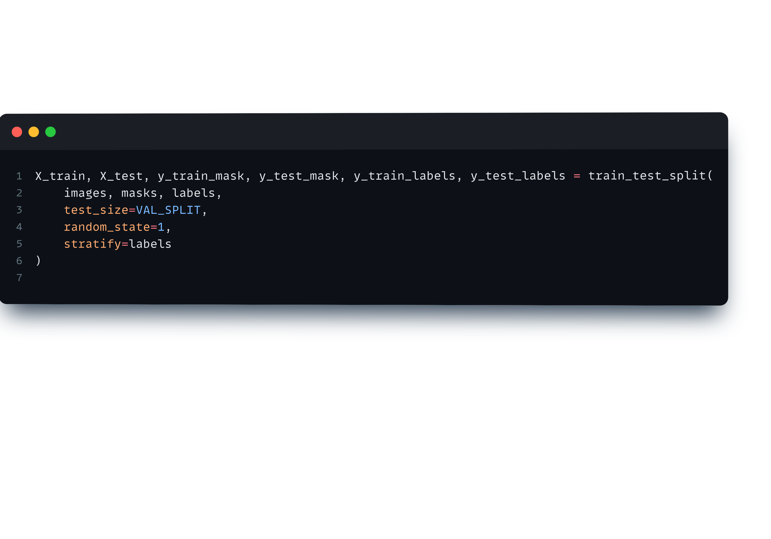
Split for X and Y

Slide 13
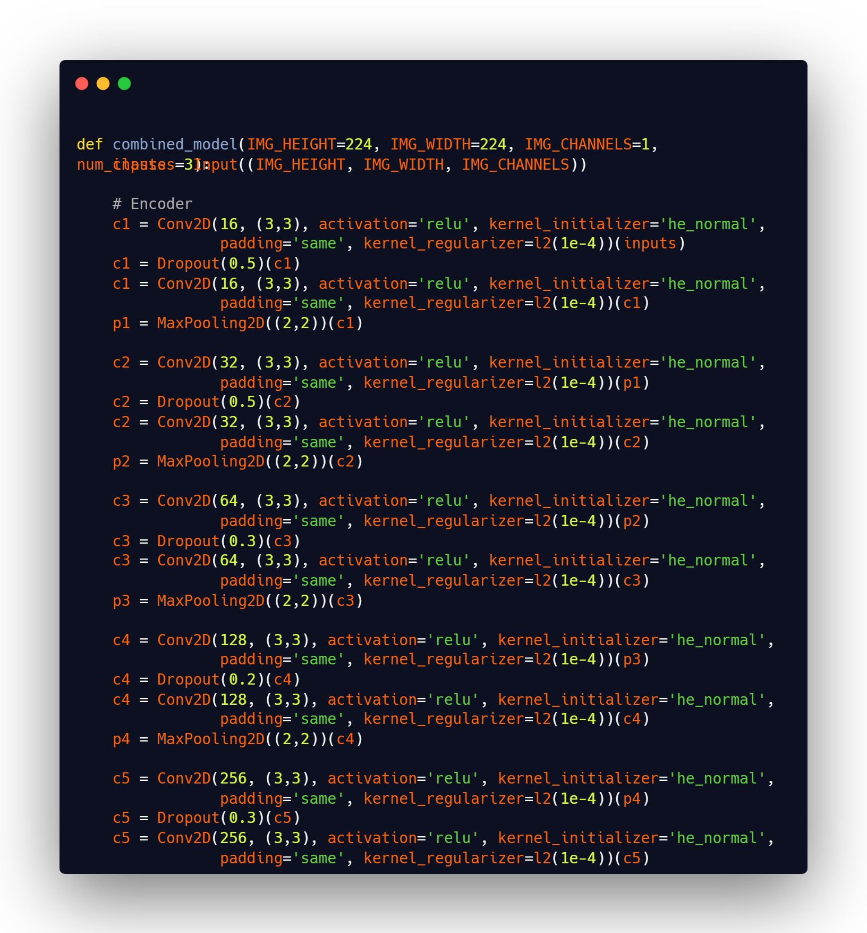
Structure for U net model
Encoder

Slide 14
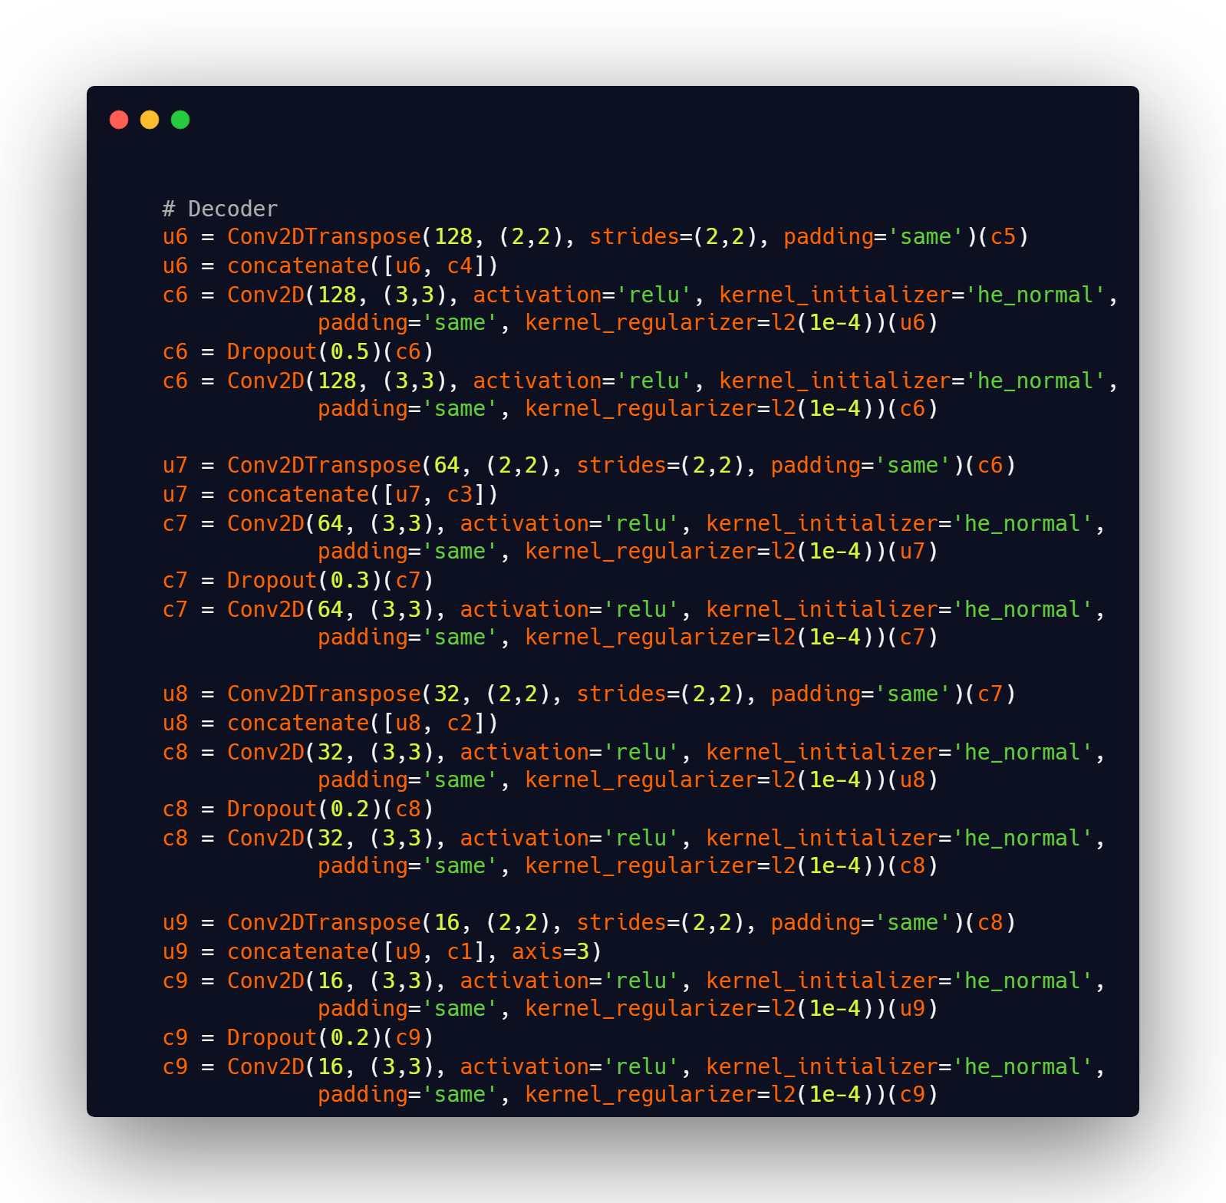
Decoder

Slide 15
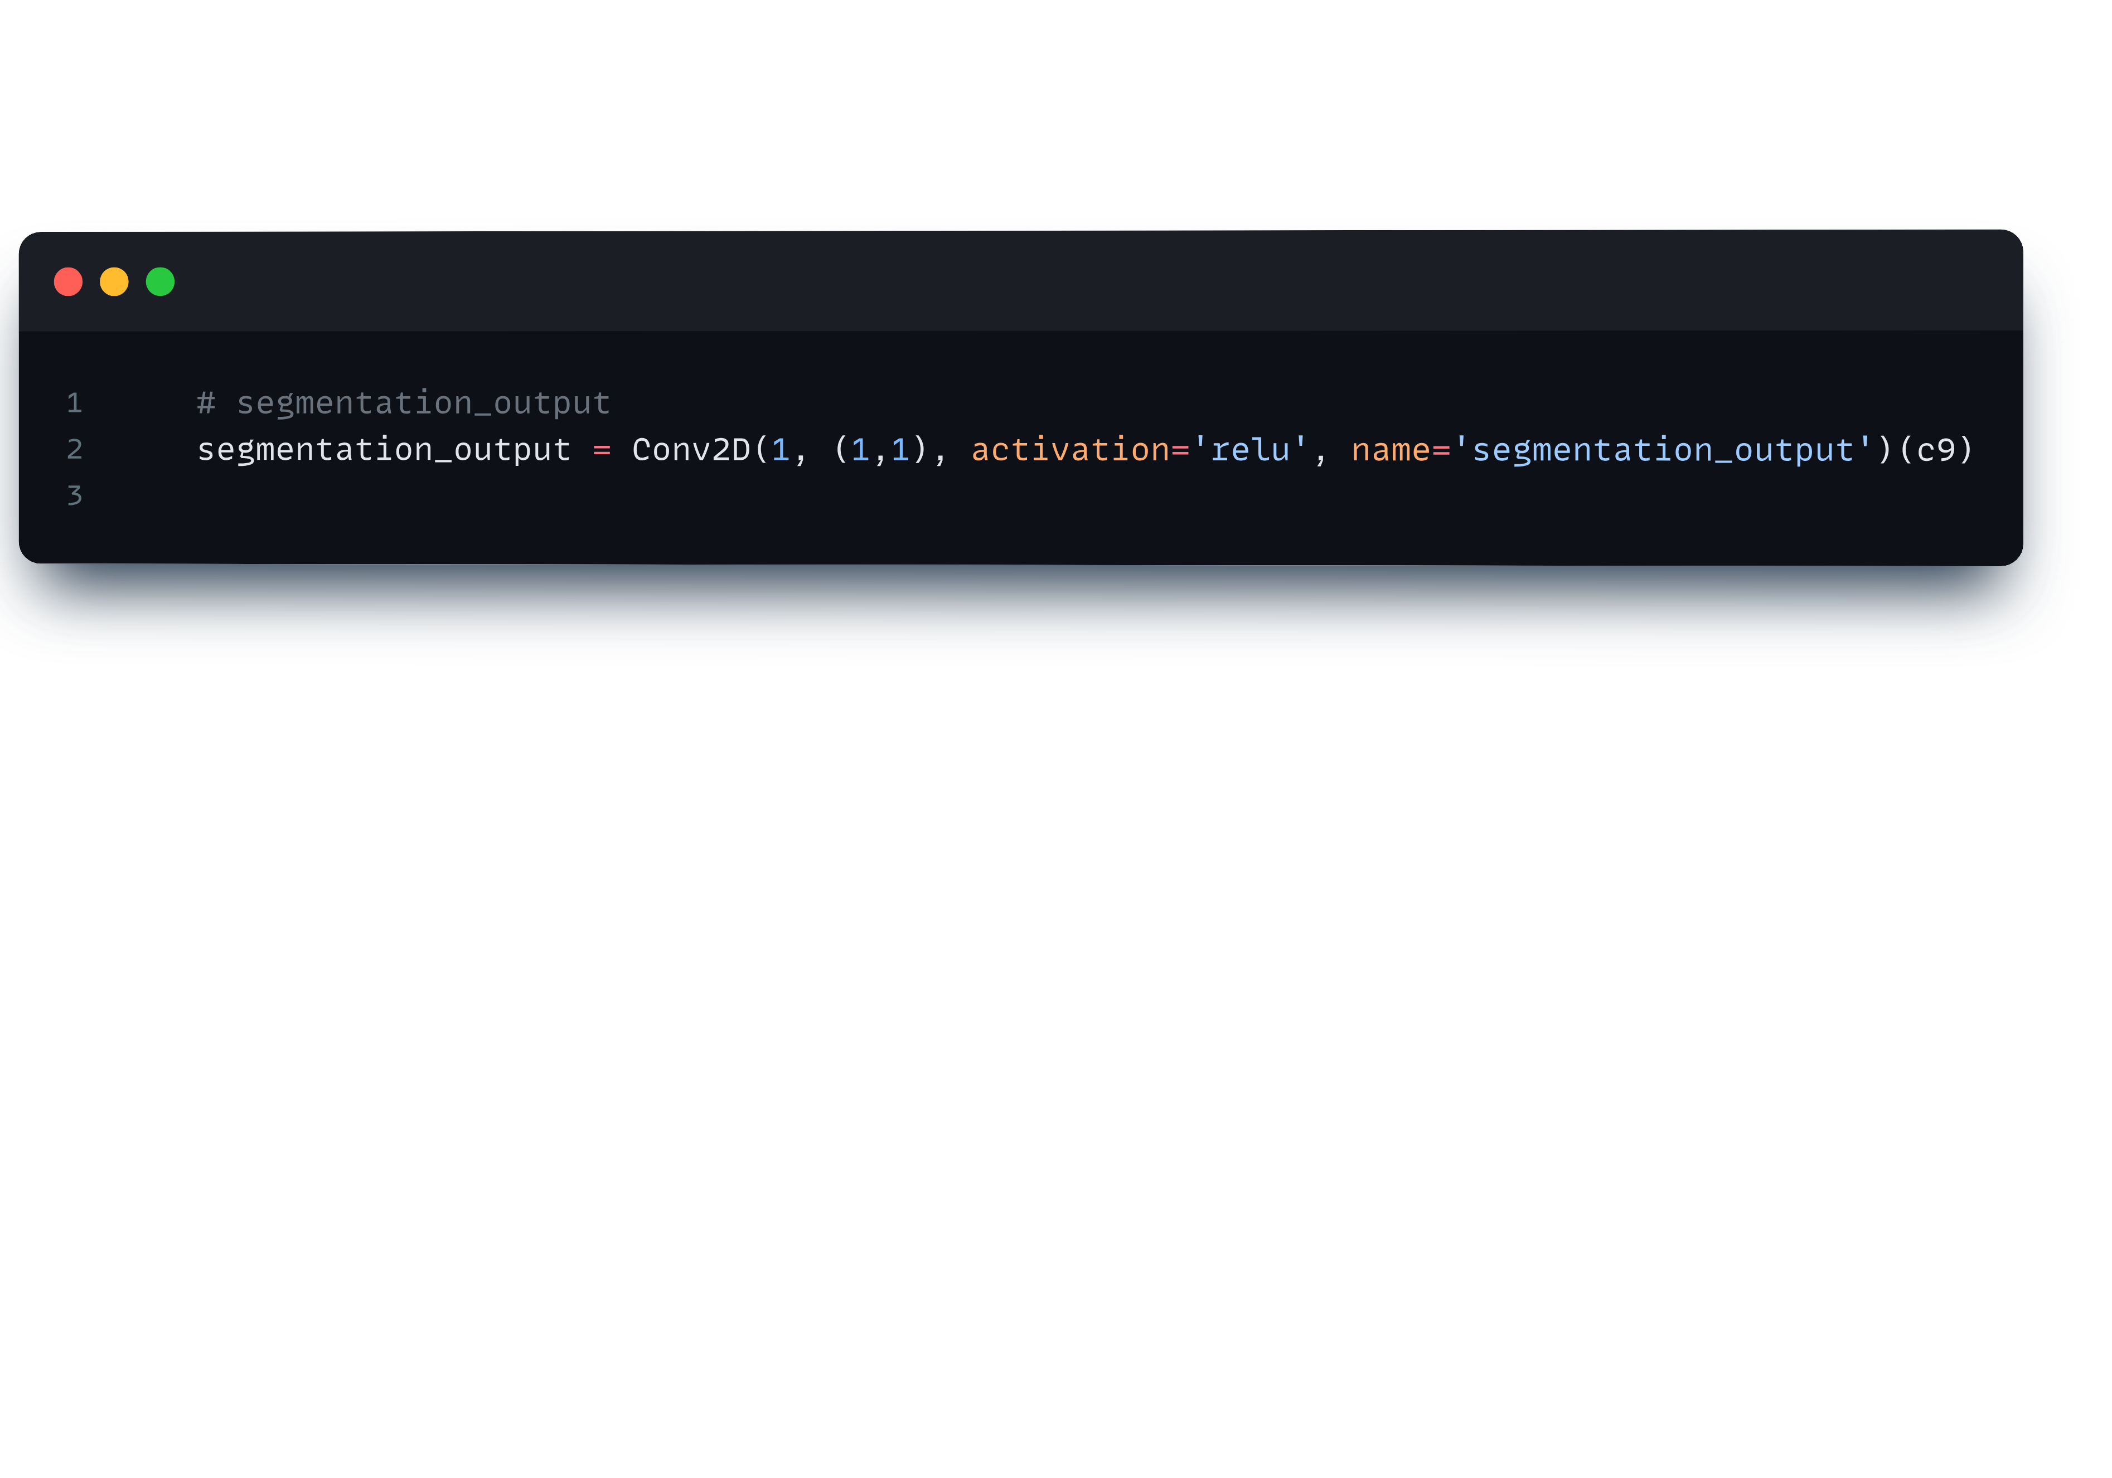
Segmentation output

Slide 16
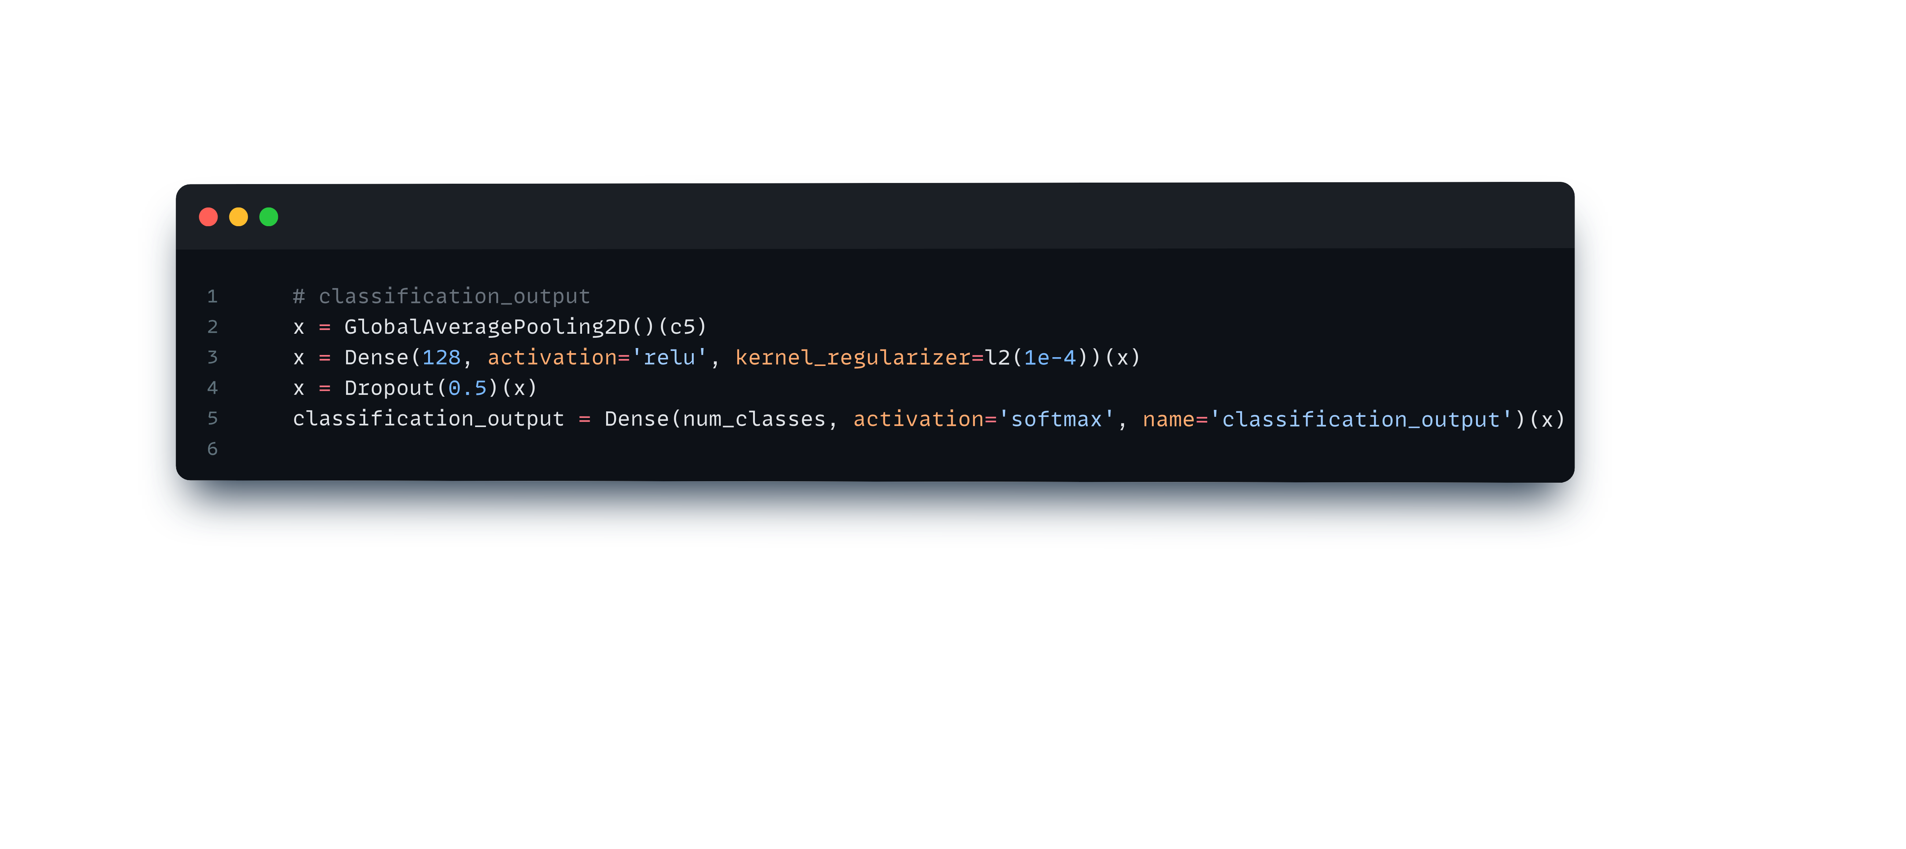
Classification Output

Slide 17
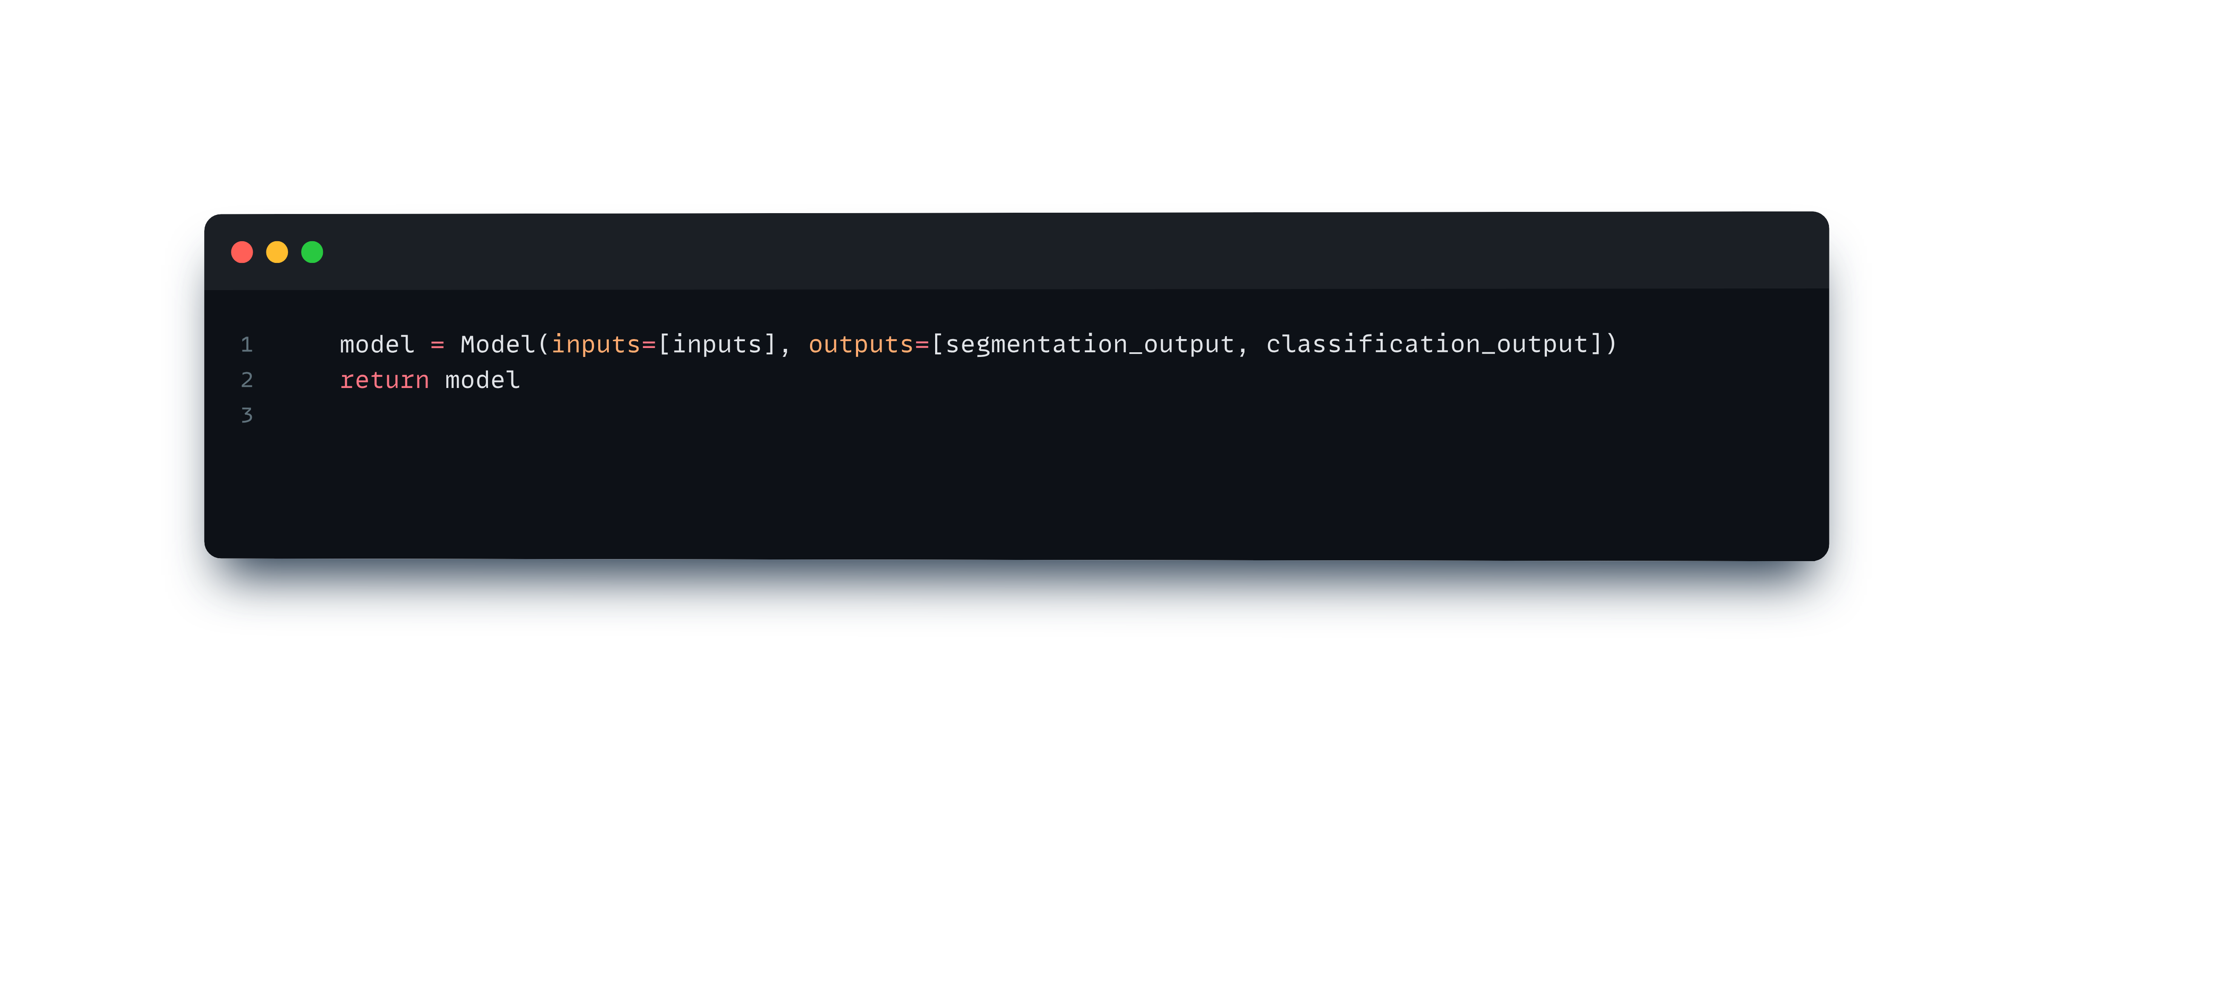
Defined and return

Slide 18
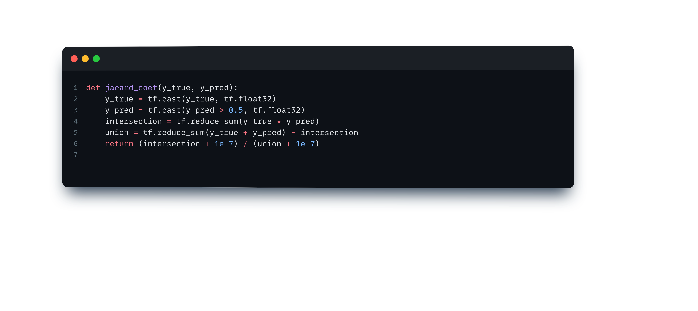
This makes sure that y_true is in the correct type format for further calculations.

Slide 19
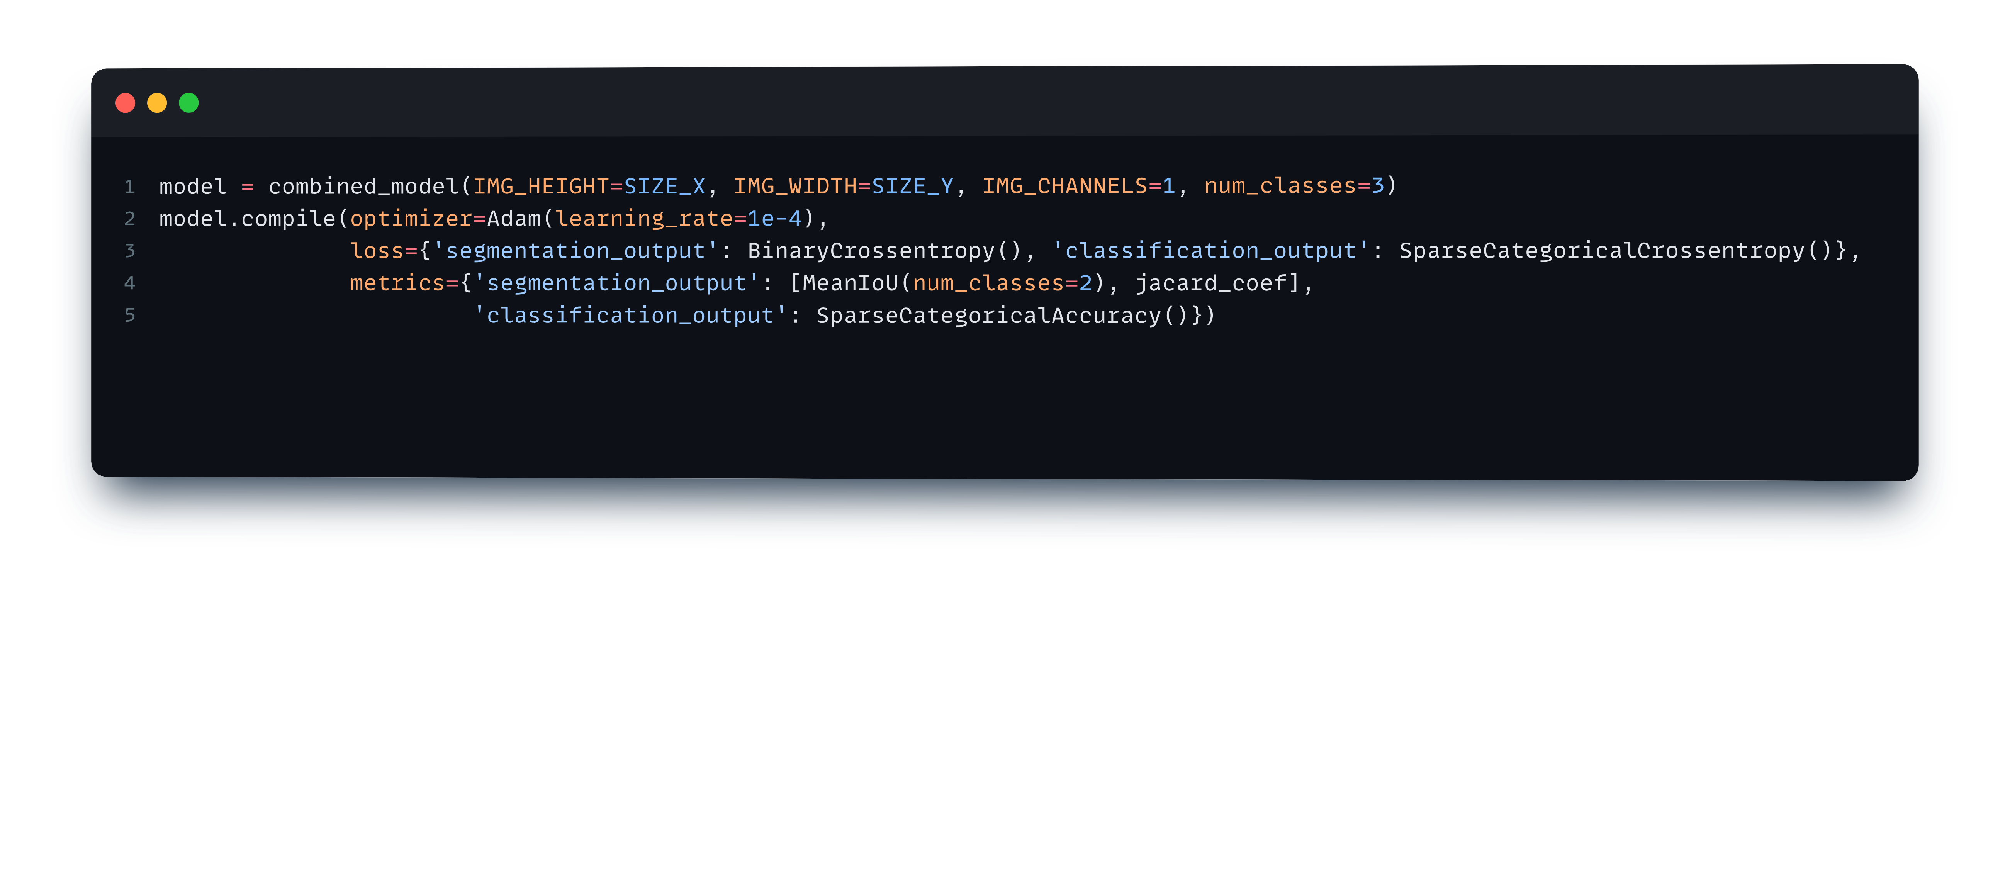
Compile model

Slide 20
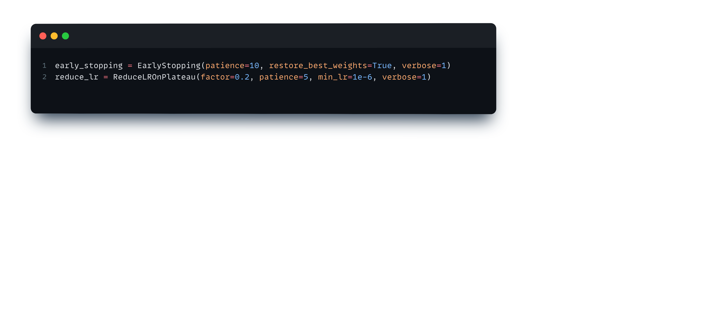
Call back

Slide 21
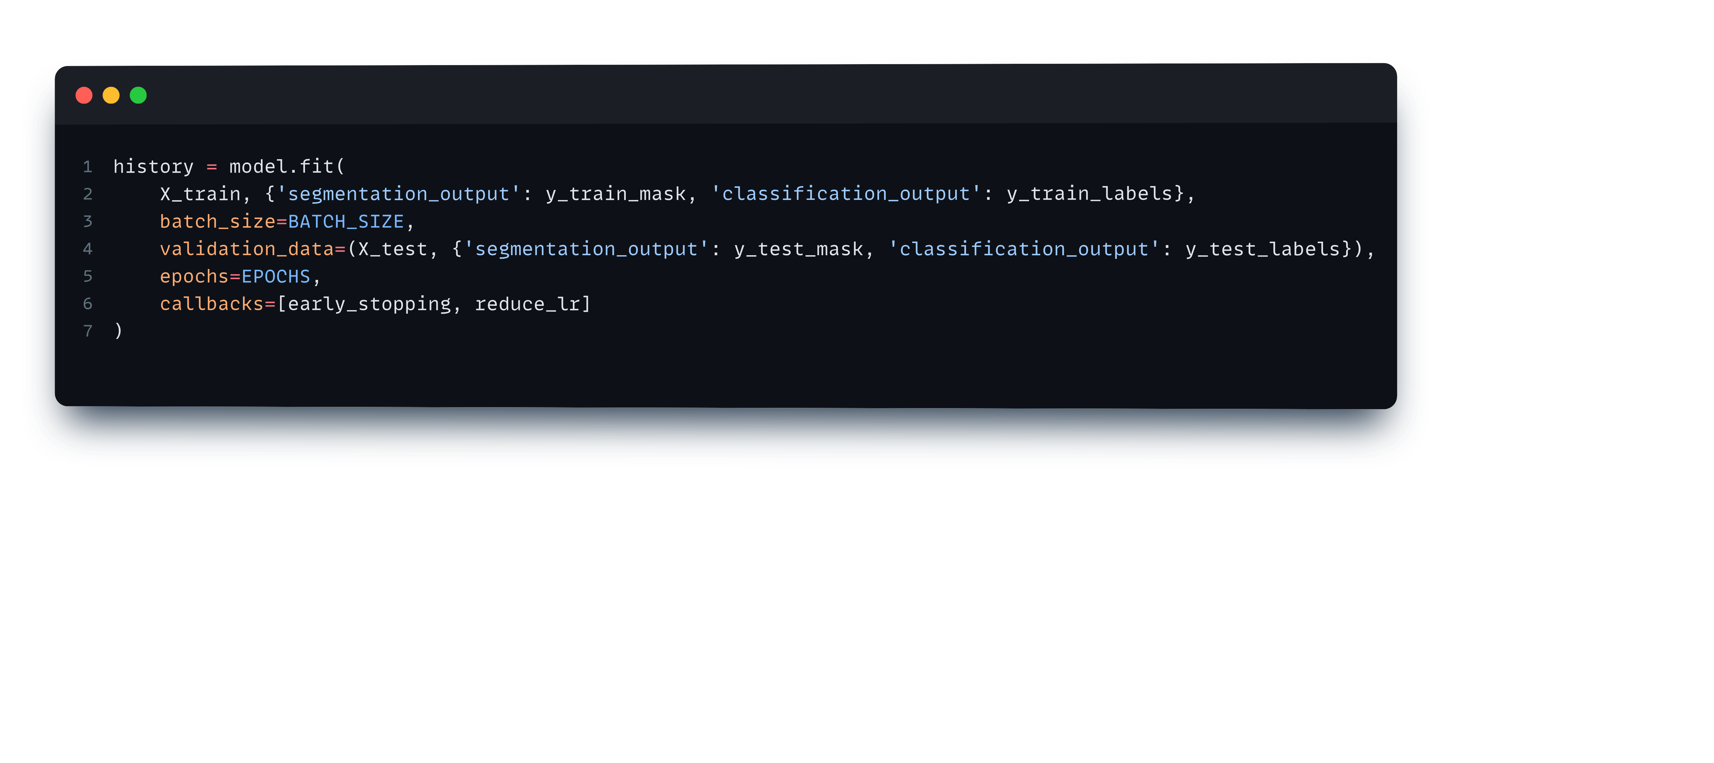
Fit model

Slide 22
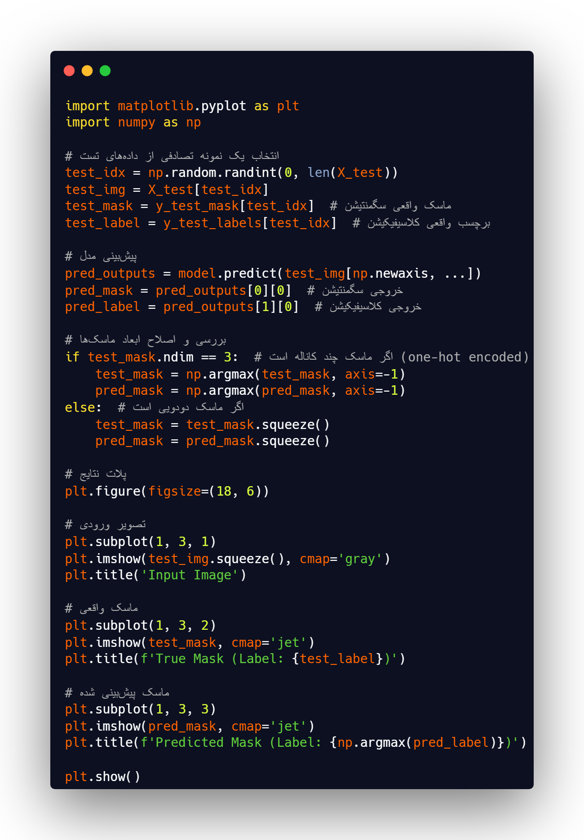
Plot out put

Slide 23
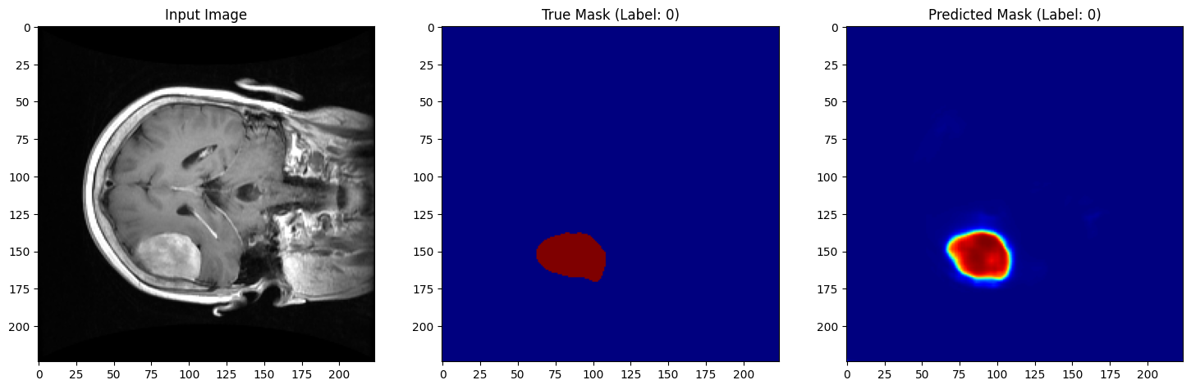
Sample output

